Slide 1
Generative AI Models (Chapter 2)
Olver Grainge

Slide 2
Learning Outcomes
By the end of this session, you will know how to:
Understand the transformer architecture and the innovations behind it:
Residual connections
Normalization
Self-Attention
FeedForward networks
Positional Encodings
How to turn a transformer into an LLM:
Pre-Training
Supervised Fine-tuning
Reinforcement Learning from Human Feedback.
LLM Inference:
Auto-regressive Generation
Prompt Processing
KV Caching
Notes:
Overview of the session's goals for optimizing CPU inference.
Algorithmic optimizations: linear quantization and network pruning.
Matrix multiplication optimizations: loop tiling, re-ordering, unrolling, and multi-threading.
SIMD acceleration techniques using Arm CPU features like NEON, SVE, and I8MM for increased data parallelism
Combining these techniques with Kleidi uKernel a low-level operator library for maximum performance.

Slide 3
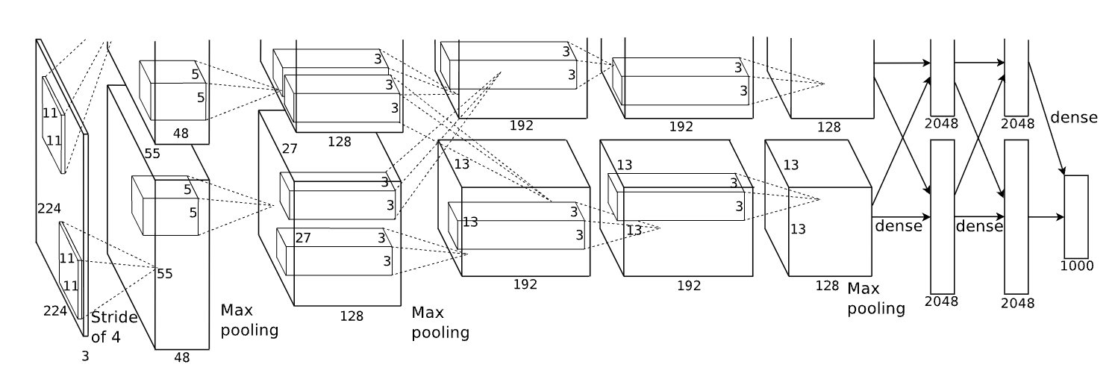


How we got here?
Rise of Deep Learning (2010s-2016s) – Multi-layer Neural Networks
AlexNet (2012) – Deep Convolutional Neural Network (CNN) that won ImageNet competition.
VGG (2014) – Demonstrated the power of deeper architectures for image recognition.
ResNet (2015) – Introduced residual connections, enabling very deep networks.
Unification of Architectures (2016-Present)
Transformers (2017, Attention Is All You Need) – Revolutionized NLP (e.g., BERT, GPT).
Vision Transformers (2020) – Applied self-attention to image processing (ViT, Swin).
Diffusion Models (2022-Present) – Leading generative models (DALL·E, Stable Diffusion).
Early AI (1950s-1990s) – Symbolic AI & Classical Machine Learning
Perceptron (1958) – Frank Rosenblatt’s simple neural network, later shown to be limited.
Backpropagation (1986) – Key breakthrough by Rumelhart, Hinton, and Williams.
Support Vector Machines (1990s) – Rise of kernel methods for classification.
AlexNet (CNN architecture)
Krizhevsky, Alex, Ilya Sutskever, and Geoffrey E. Hinton. "Imagenet classification with deep convolutional neural networks." Advances in neural information processing systems 25 (2012).
Notes:
Early AI (1950s-1990s) focused on symbolic reasoning and classical machine learning methods like perceptrons, backpropagation, and support vector machines.
The rise of deep learning (2000s-2010s) saw breakthroughs like AlexNet, VGG, and ResNet, which enabled much deeper neural networks.
The 2010s onward marked the unification of architectures, with transformers revolutionizing NLP and vision models, and diffusion models pushing generative AI forward.

Slide 4
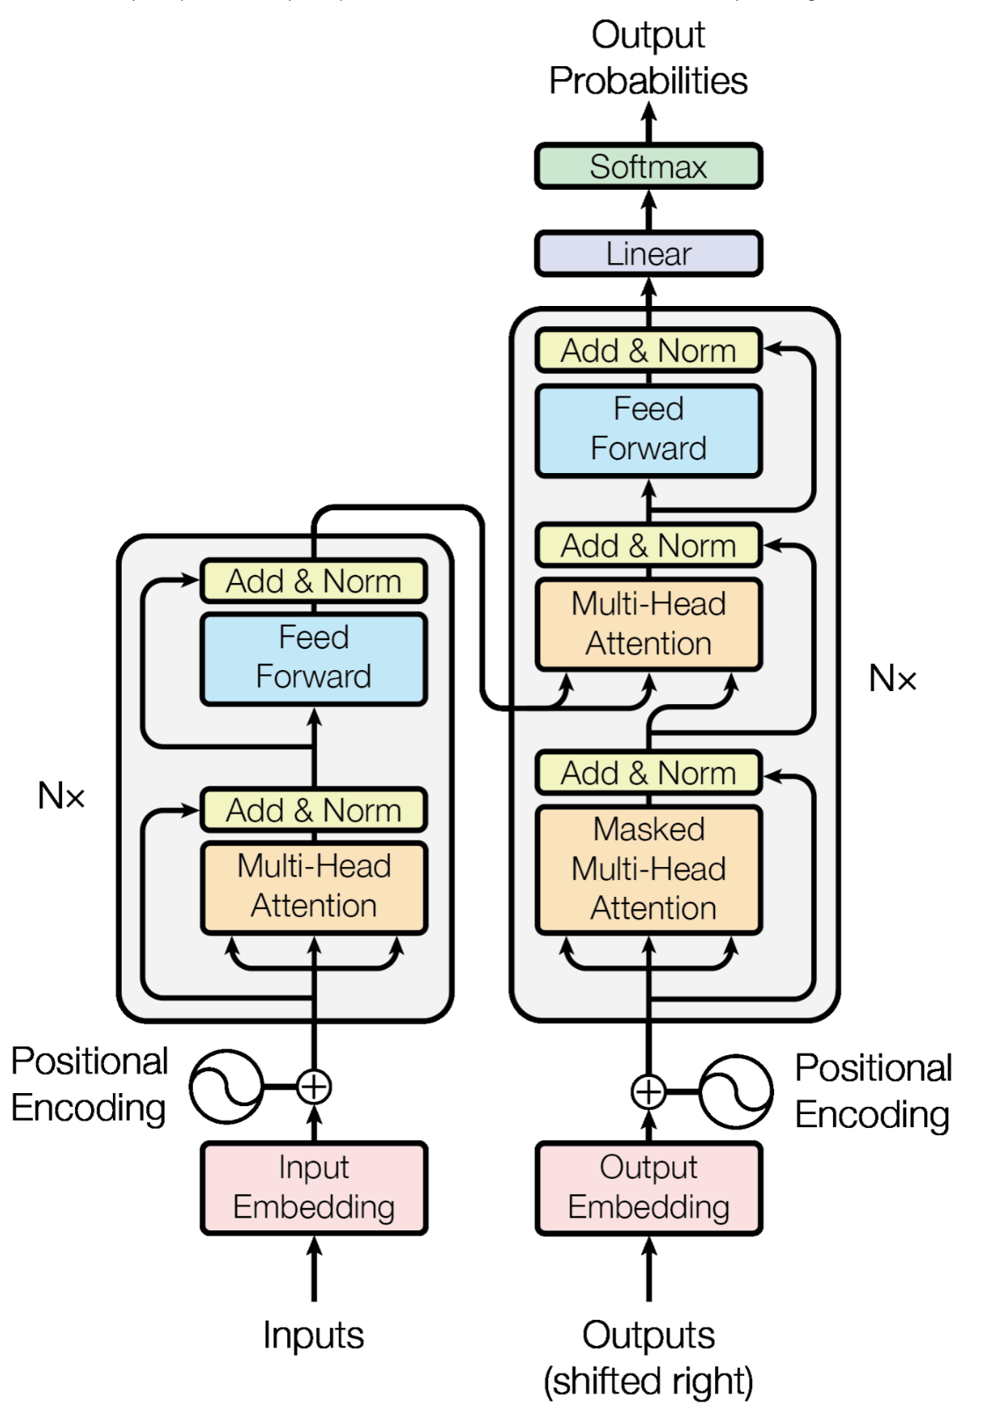
The Transformer
The transformer is becoming the default architecture for the majority of applications
Why?
No inductive biases
Ability to model Long-range Dependencies
Extremely Parallelizable
Very General Representations
Key Innovations:
Residual Connections
Layer Normalization
Self-Attention
Feedforward Networks
Positional Encodings
Vaswani, A., Shazeer, N., Parmar, N., Uszkoreit, J., Jones, L., Gomez, A. N., Kaiser, Ł., & Polosukhin, I. (2017). Attention is all you need. Advances in Neural Information Processing Systems, 2017-December.
Notes:
Transformers have become the dominant architecture for modern AI applications.
They outperform traditional models due to their ability to model long-range dependencies without inductive biases.
They are highly parallelizable, making them efficient for large-scale training.
Key innovations include self-attention, residual connections, layer normalization, and positional encodings.

Slide 5
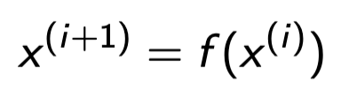
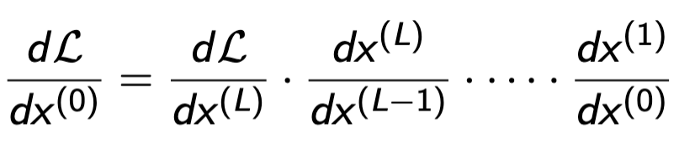
Vanishing Gradients
Purpose: Before we can understand the importance of residual connections in deep neural networks, we must first examine a key challenge in training deep models — the vanishing gradient problem.
Forward Pass: For a feedforward network with layers indexed by i.
Backward pass: Gradient Propagation
The gradient of the loss w.r.t. the input to earlier layers is a product of Jacobians from later layers. If the derivative of each layer is bounded by a value less than 1 (e.g., sigmoid/tanh), the gradients shrink exponentially with depth. This leads to: Slow or stalled learning in shallow layers and Poor gradient flow during backpropagation
Notes:
Residual connections help stabilize training by improving gradient flow in deep models.
They prevent vanishing gradients by allowing direct information flow through identity mappings.
They accelerate convergence by keeping gradients well-behaved, leading to faster training.
They help models refine rather than overwrite learned representations, improving learning efficiency.

Slide 6
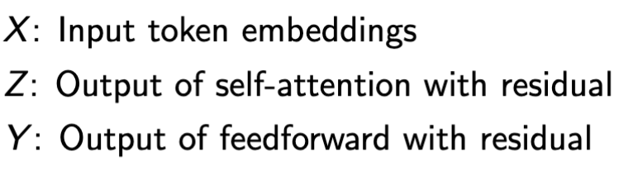
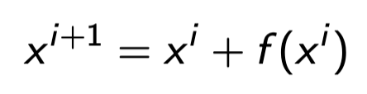
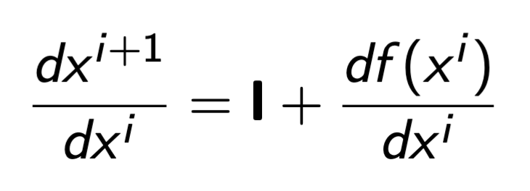


Residual Connections
Purpose: Residual connections help stabilize training and improve gradient flow in deep transformer models. A residual forward pass is defined as:
Backward Pass: During Backpropagation e.g. when computing the gradient of the outputs with respect to the inputs of the residual forward pass.
The presence of the identity matrix gradient term ensures that even if the gradient of the layer is small, the total gradient is bounded below by 1, thus helping avoid vanishing when using the chain rule as 1.
Key Benefits:
Stabilizes training: Prevents vanishing gradients by allowing direct information flow
Speeds up Convergence: Helps optimization by keeping gradients well-behaved
Retains Information input: Enables the model to refine rather than overwrite representations
Notes:
Residual connections help stabilize training by improving gradient flow in deep models.
They prevent vanishing gradients by allowing direct information flow through identity mappings.
They accelerate convergence by keeping gradients well-behaved, leading to faster training.
They help models refine rather than overwrite learned representations, improving learning efficiency.

Slide 7
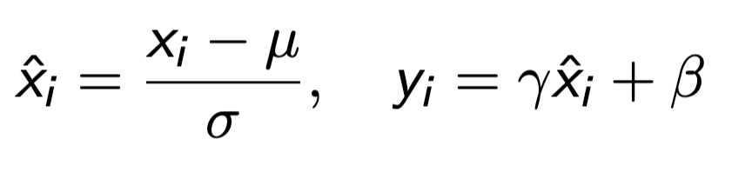
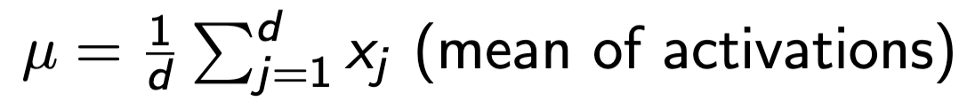
Layer Norms
Purpose: Layer normalization stabilizes activations and improves training efficiency in deep transformer models.
Where:
Key benefits:
Reduces Internal Co-variate shift: Normalizing inputs to prevent unstable gradients
Improves Gradient Flow: Keeps gradients well-scaled during backpropagation.
Essential in Transformers: Unlike BatchNorm, works well with variable-length sequences.
Notes:
Layer normalization stabilizes activations and improves training efficiency.
It normalizes inputs to prevent unstable gradients and improve training dynamics.
It ensures well-scaled gradients during backpropagation, preventing gradient explosion or vanishing.
Unlike batch normalization, layer norm works well with variable-length sequences, making it ideal for transformers.

Slide 8
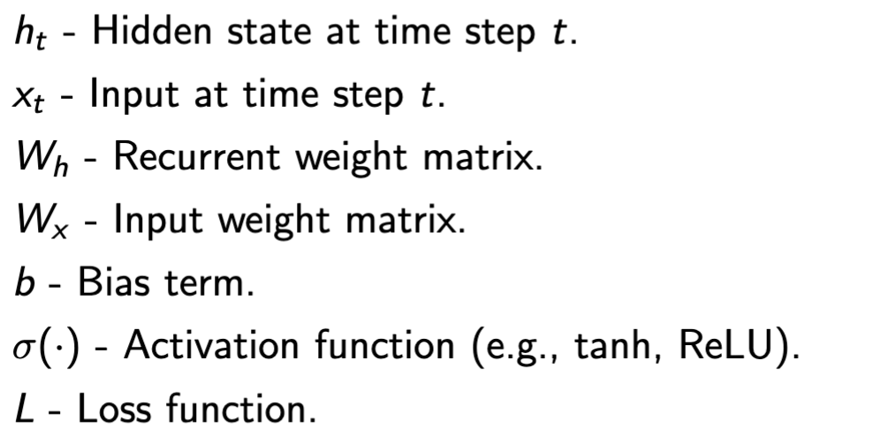
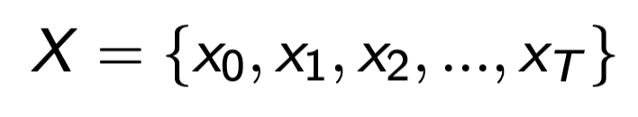
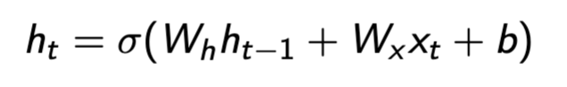
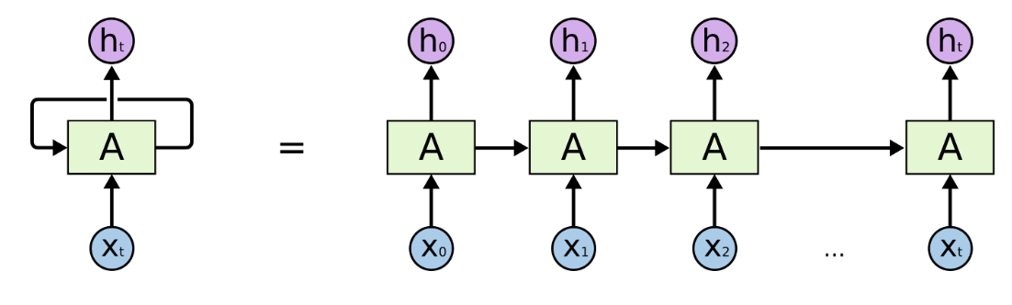
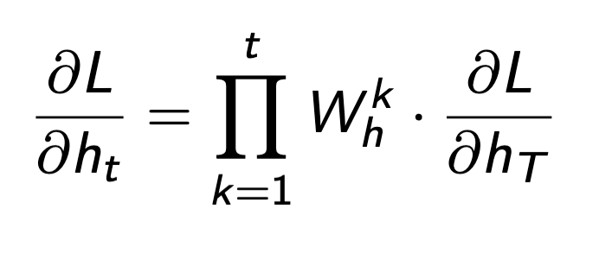
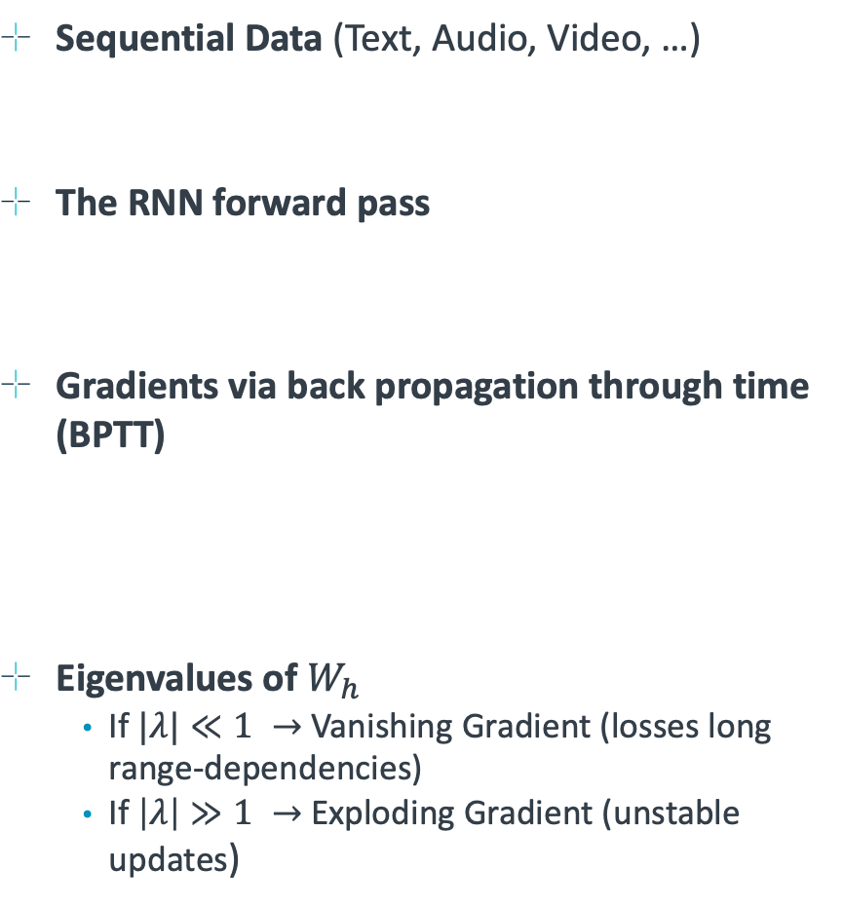
Precursor to Attention: The RNN
Sequential Data (Text, Audio, Video, …)
The RNN forward pass
Gradients via back propagation through time (BPTT)
Eigenvalues of $W_{h}$
If $|λ|≪1 →$ Vanishing Gradient (losses long range-dependencies)
If $\left|λ\right|≫1 →$ Exploding Gradient (unstable updates)
Challenging to train due to exploding gradients
Difficult to handle long sequences due to vanishing gradients
Difficult to parallelize and scale due to BPTT
M. Schuster and K. K. Paliwal, "Bidirectional recurrent neural networks," in IEEE Transactions on Signal Processing, vol. 45, no. 11, pp. 2673-2681, Nov. 1997, doi: 10.1109/78.650093.
Notes:
Recurrent Neural Networks (RNNs) process sequential data like text, audio, and video.
Backpropagation through time (BPTT) enables training but suffers from vanishing and exploding gradients.
RNNs struggle with long-range dependencies, limiting their ability to capture long-term relationships.
They are difficult to parallelize, making them inefficient for large-scale models.

Slide 9
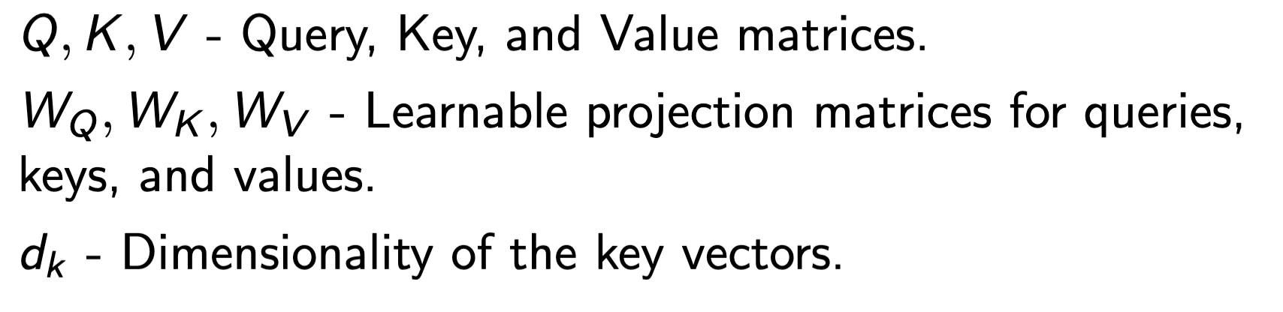
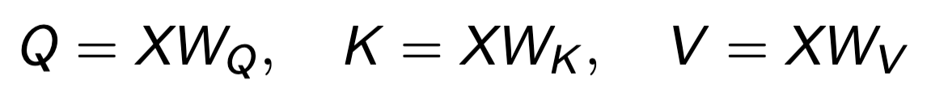
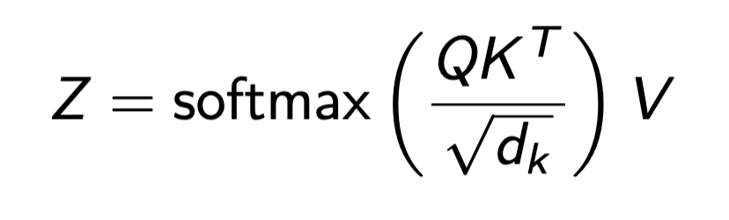
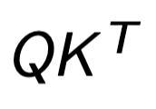
Self-Attention
Sequential Data (Text, Audio, Video, …)
Self-Attention
The entire sequence of data is projected into subspaces using learned weight matrices
Computing Scaled Dot-product Attention
computes pairwise relevance between data in the sequence.
Self-Attention has quadratic space complexity in the sequence length.
Self-Attention does not inherently understand order of data in the sequence.
Notes:
Self-attention allows models to compute dependencies between all elements in a sequence simultaneously.
Queries, keys, and values are used to compute scaled dot-product attention, determining relevance between elements.
It enables more flexible modeling of dependencies compared to RNNs but has quadratic space complexity.
Unlike RNNs, self-attention does not inherently capture the order of data, requiring positional encodings.

Slide 10
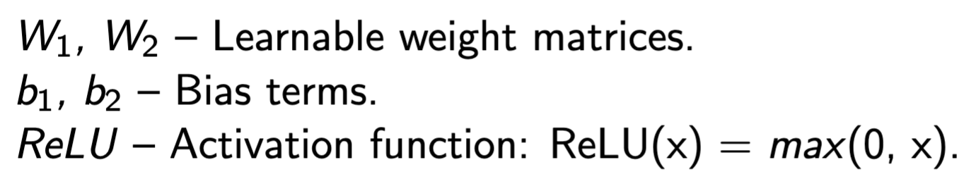
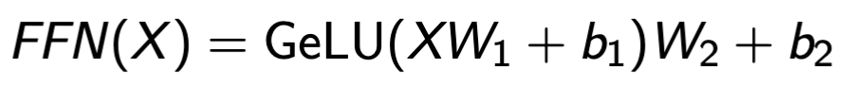
Feedforward Networks
Purpose: Feed Forward Networks (FFN) introduce non-linearity and enhance feature learning in transformers by processing token-wise representations independently. In transformers it is common to use a GeLU activation (smooth version of ReLU)
Mathematical Formulation
Key Properties:
Enhances Feature Learning: Learns hierarchical features beyond self-attention .
Computationally Efficient: Operates independently on each positions, enabling parallelism.
Layer-wise Independence: Processes each token separately without mixing contextual information.
Notes:
Feedforward networks introduce non-linearity and enhance feature learning in transformers.
They process token-wise representations independently, making them efficient for large-scale models.
The activation function, typically GeLU, introduces non-linearity to enable complex feature extraction.
Feedforward networks enhance hierarchical learning beyond self-attention.
They operate independently on each position, allowing efficient parallelization.

Slide 11
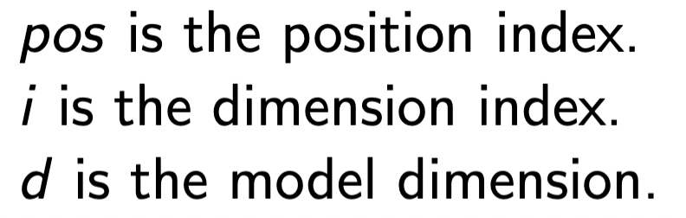
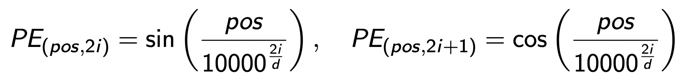
Positional Encodings
Why Positional Encodings?
Transformers lack inherent sequence order information (unlike RNNs)
Positional Encodings introduce order awareness into self-attention
Mathematical Formulation:
Key Properties:
Encodes Relative and Absolute Positioning: Captures long-range dependencies.
Smooth Variations Across Positions: Enables generalization to unseen sequences.
No Additional Parameters: Fixed function, does not require training.
Notes:
Transformers lack inherent sequence order information, unlike RNNs.
Positional encodings introduce order awareness into self-attention.
The encoding function captures relative and absolute positioning to help the model understand long-range dependencies.
Smooth variations in positional encodings improve generalization to unseen sequences.
They do not require additional trainable parameters, making them computationally efficient.

Slide 12
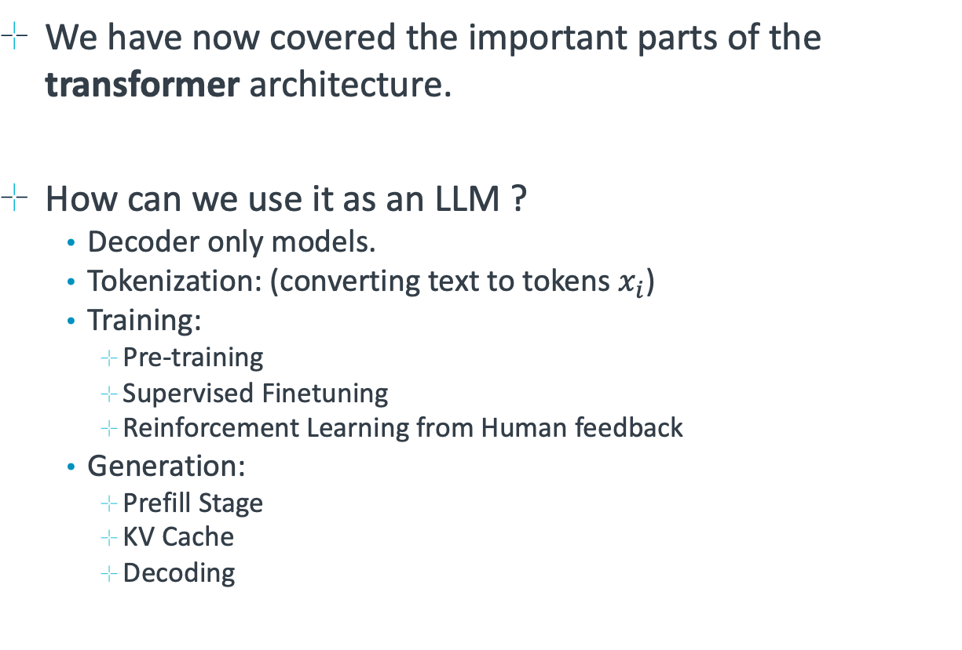
Natural Language Processing
We have now covered the important parts of the transformer architecture.
How can we use it as an LLM ?
Decoder only models.
Tokenization: (converting text to tokens $x_{i}$)
Training:
Pre-training
Supervised Finetuning
Reinforcement Learning from Human feedback
Generation:
Prefill Stage
KV Cache
Decoding
Vaswani, A., Shazeer, N., Parmar, N., Uszkoreit, J., Jones, L., Gomez, A. N., Kaiser, Ł., & Polosukhin, I. (2017). Attention is all you need. Advances in Neural Information Processing Systems, 2017-December.
Notes:
The transformer architecture underpins modern natural language processing (NLP).
Large language models (LLMs) typically use decoder-only transformers.
Tokenization converts text into numerical representations for model processing.
Training involves pre-training on large text corpora and supervised fine-tuning for alignment.
Generation stages include prefill, KV caching, and decoding.

Slide 13
Tokenization
The process of converting text, into sequences of embeddings.
”The hare jumped over … fox” ->
Types of Tokenization:
Word-based Tokenization: Splits text into words, but struggles with unseen words (e.g., "unhappiness" → ["unhappiness"], unknown word issue).
Character-based Tokenization: Splits text into characters, avoiding out-of-vocabulary (OOV) issues but increasing sequence length.
Subword Tokenization: Balances between word and character methods, allowing for efficient vocabulary usage (e.g., Byte-Pair Encoding, WordPiece, SentencePiece).
Encoding Process:
Raw text input is normalized (e.g., lowercasing, removing special characters).
Tokenization algorithm splits text into meaningful units.
Each token is mapped to a unique integer index in the vocabulary.
Token indices are embedded into a continuous vector space for model input.
Notes:
Tokenization converts text into a sequence of embeddings for neural network processing.
Word-based tokenization splits text into words but struggles with unseen vocabulary.
Character-based tokenization avoids out-of-vocabulary issues but increases sequence length.
Subword tokenization, like Byte-Pair Encoding and WordPiece, balances efficiency and vocabulary size.
The encoding process normalizes text, splits into meaningful units, maps tokens to indices, and embeds them into vector space.

Slide 14
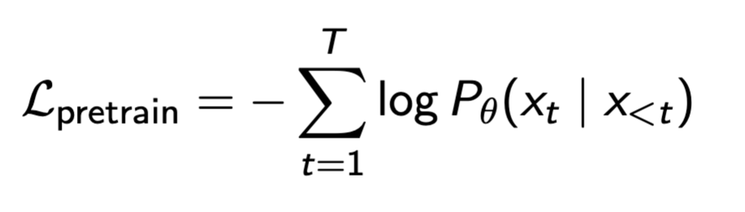
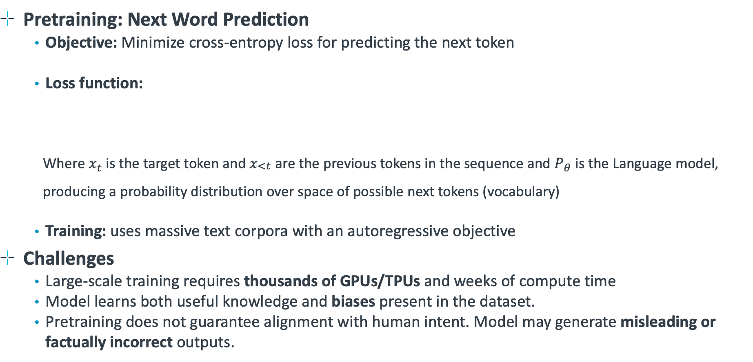
The Training Recipe (step 1: Pre-training)
Pretraining: Next Word Prediction
Objective: Minimize cross-entropy loss for predicting the next token
Loss function:
Where $x_{t}$ is the target token and $x_{\begin{aligned}<t \\ \end{aligned}}$ are the previous tokens in the sequence and $P_{θ}$ is the Language model, producing a probability distribution over space of possible next tokens (vocabulary)
Training: uses massive text corpora with an autoregressive objective
Challenges
Large-scale training requires thousands of GPUs/TPUs and weeks of compute time
Model learns both useful knowledge and biases present in the dataset.
Pretraining does not guarantee alignment with human intent. Model may generate misleading or factually incorrect outputs.
Notes:
Pre-training uses next-word prediction as an objective, minimizing cross-entropy loss.
The model is trained on large text corpora in an autoregressive fashion.
Large-scale training requires thousands of GPUs/TPUs and weeks of compute time.
The model learns both useful patterns and biases present in the dataset.
Pre-training does not guarantee alignment with human intent and may generate misleading or incorrect outputs.

Slide 15
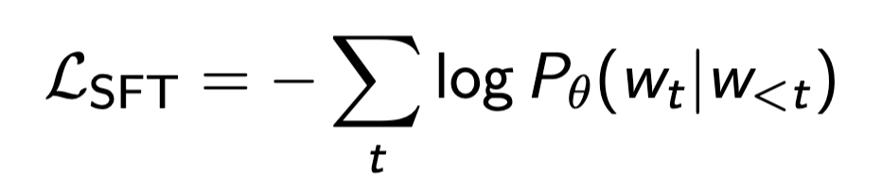
Supervised Fine-tuning
After Pre-training the model is fine-tuned on high-quality human annotated datasets.
Goal: improve task-specific performance and align model outputs with human intent
Loss function: Remains Cross-entropy, encouraging model to predict human-preferred responses
Differences: Loss is only applied on the response. E.g. (on the A of a Q/A)
Key improvements from SFT:
Reduces factual errors and improves coherence
Encourages safer and more aligned responses
Helps mitigate biases from pre-training
Fine-tunes performance on specific benchmarks and tasks.
Notes:
After pre-training, models are fine-tuned on high-quality human-annotated datasets.
The goal is to improve task-specific performance and align outputs with human intent.
The loss function remains cross-entropy but is applied selectively to responses.
Fine-tuning reduces factual errors, improves coherence, and encourages safer responses.
It helps mitigate biases from pre-training and improves performance on benchmarks.

Slide 16
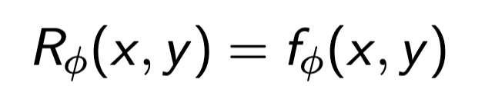
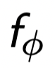
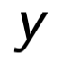

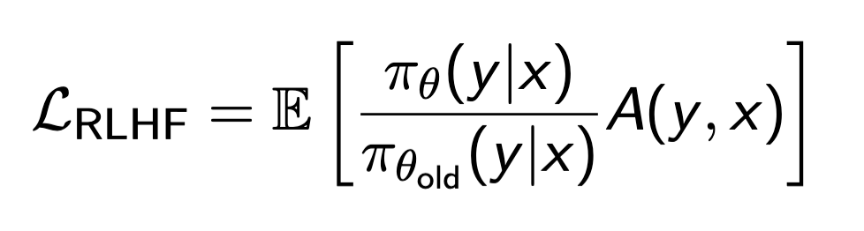
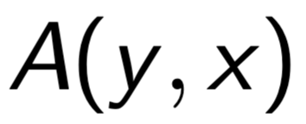

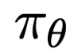
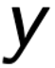

Alignment training with (RLHF)
Aligning the with Reinforcement Learning from human feedback (RLHF).
Have you ever been asked to select a preferred response with an LLM Service?
Step 1: Reward Modelling – trained using human preference data:
Where is the learned function scoring the response from input .
Step 2: Policy Optimization – Uses proximal policy optimization (PPO)
where is the advantage functions derived from rewards, is the Expectation function and is the policy (Language model, predicting how likely answer is under question )
Ensures responses align with human values while maintaining fluency.
Produces gradients to update the model to produce responses closer to those preferred by the users.
Notes:
Reinforcement Learning from Human Feedback (RLHF) aligns model outputs with user preferences.
Reward modeling is trained using human preference data to score responses.
Policy optimization uses Proximal Policy Optimization (PPO) to refine responses.
Ensures responses align with human values while maintaining fluency.
Produces gradients that update the model to generate more user-preferred responses.

Slide 17
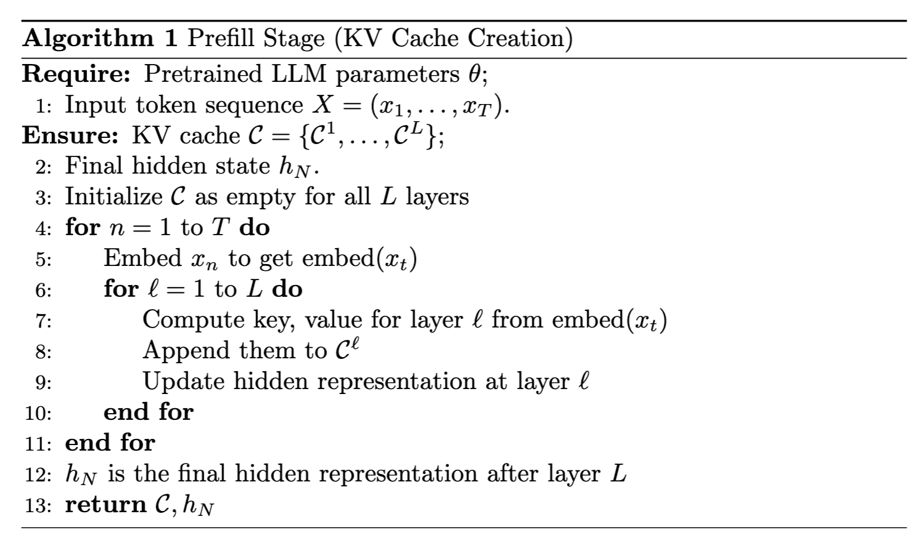
Efficient LLM Inference (Prefill Stage)
LLM inference = Prefill stage + Decoding
FFNs operate on elements in the input sequence in isolation.
Attention aggregates information from the entire sequence.
When generating the next token of the response, the attention mechanism requires attention activations from the input prompt. Namely the Keys, and Values thereby called the KV Cache.

Slide 18
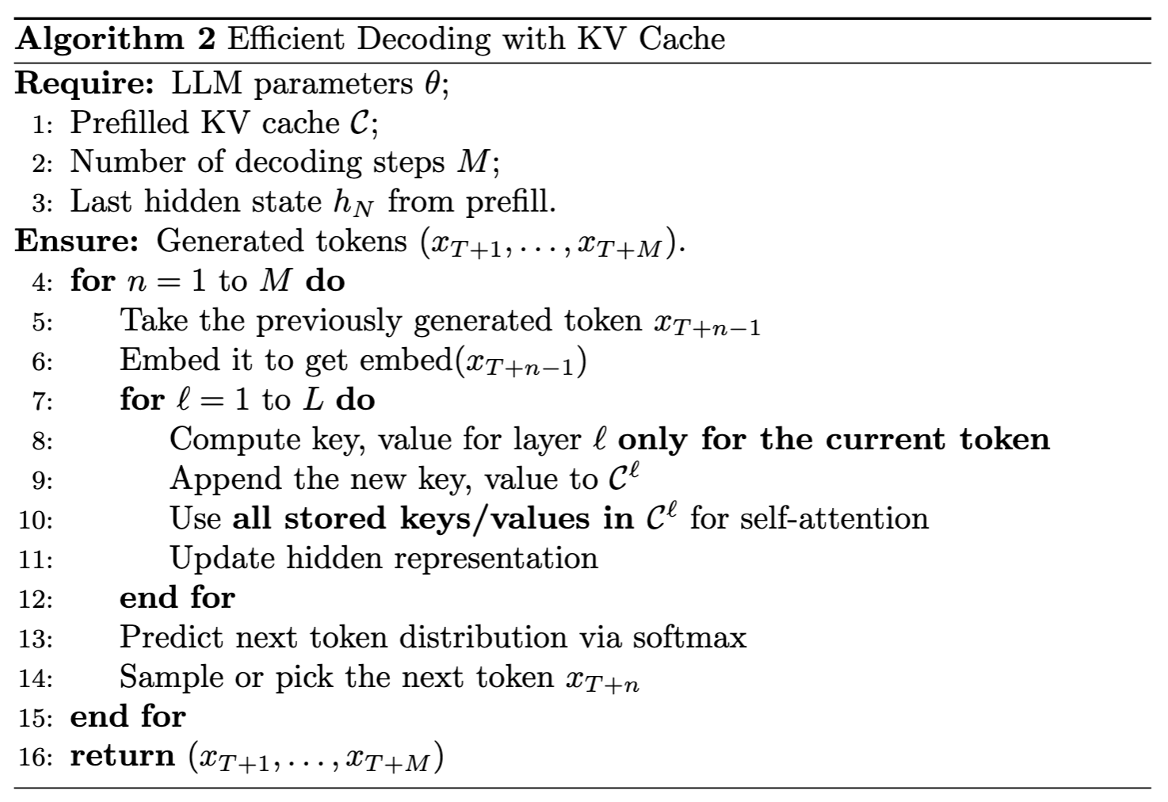
Decoding
Definition: The model generates new tokens sequentially, using previously computed KV pairs for efficiency.
Each decode step produces a probability distribution over the next tokens in the sequence.
KV Caching avoids re-computation of attention inputs
Notes:
Decoding generates new tokens sequentially, using previously computed key-value (KV) pairs for efficiency.
Each step in the decoding process produces a probability distribution over possible next tokens.
KV caching stores previously computed attention values to avoid redundant computations.
This method significantly improves inference efficiency by reducing the need to recompute attention inputs for each new token.

Slide 19
Summary
Unification of Architectures (The Transformer)
Transformer Architecture
Key Innovations:
Self-Attention
Residual Connections
Feedforward Network
Positional Encodings
Training an LLM
Stages:
Large scale self-supervised training (next character prediction)
Supervised-finetuning (Fine-tune response on high quality data)
RLHF from user preferences.
Efficient Inference
LLM response = Prefill Stage + Decoding Stage
KV caching avoids redundant re-computation
Vaswani, A., Shazeer, N., Parmar, N., Uszkoreit, J., Jones, L., Gomez, A. N., Kaiser, Ł., & Polosukhin, I. (2017). Attention is all you need. Advances in Neural Information Processing Systems, 2017-December.
Notes:
Transformers unify AI architectures, making them the dominant model for NLP and other domains.
Key transformer innovations include self-attention, residual connections, feedforward networks, and positional encodings.
Training large language models (LLMs) involves multiple stages: pretraining, supervised fine-tuning, and reinforcement learning from human feedback (RLHF).
Efficient inference relies on a two-stage process: the prefill stage and the decoding stage.
KV caching enhances decoding speed by minimizing redundant computation.

Slide 20
Questions and Discussion

